Slide 1
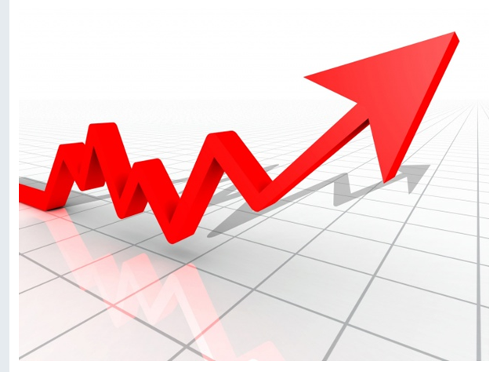
GDP
MALAYSIA

Slide 2
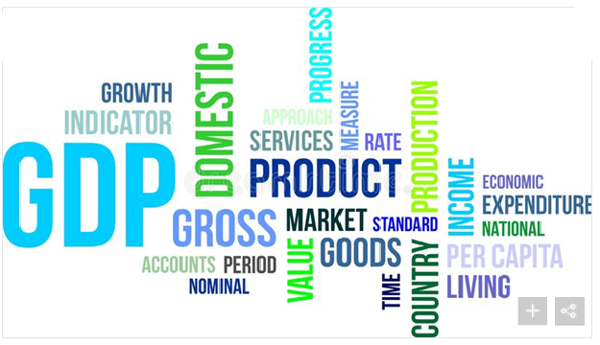
DEFINATION
GDP is defined as "an aggregate measure of production equal to the sum of the gross values added of all resident and institutional units engaged in production (plus any taxes, and minus any subsidies, on products not included in the value of their outputs.
  Monetary value of final goods and services.
  Contributes on each industry or sector of the economy.
  Mean Standard of Living.

Slide 3
MALAYSIA - GDP

Slide 4
OVERALL ANALYSIS OF GDP IN MALAYSIA CONSIDERING ALL THE SECTORS
SERVICES: Wholesale , information and communication.
MANUFACTURING : Electronic, petroleum, chemical and plastic products .
AGRICULTURE : Rubber, oil palm.
CONSTRUCTION : Civil engineering and residential building.
MINING AND QUARRYING : Production of crude oil and natural gas.

Slide 5
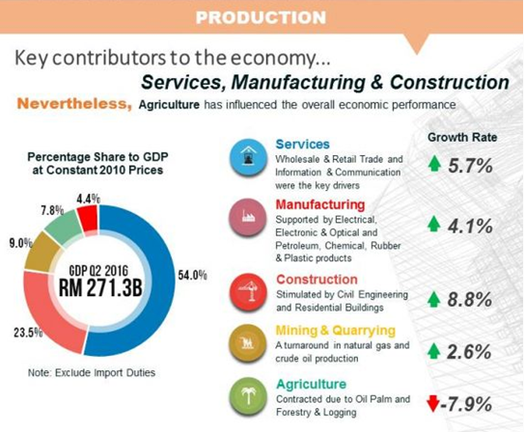
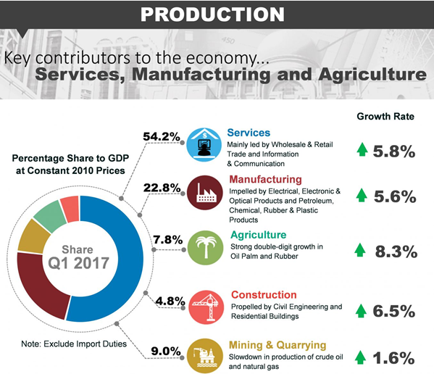
2016
2017

Slide 6
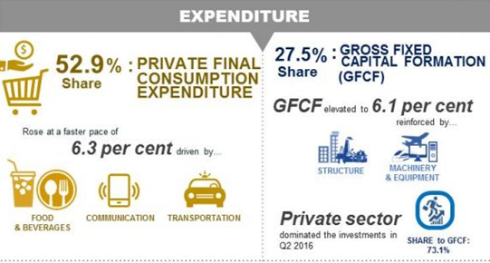
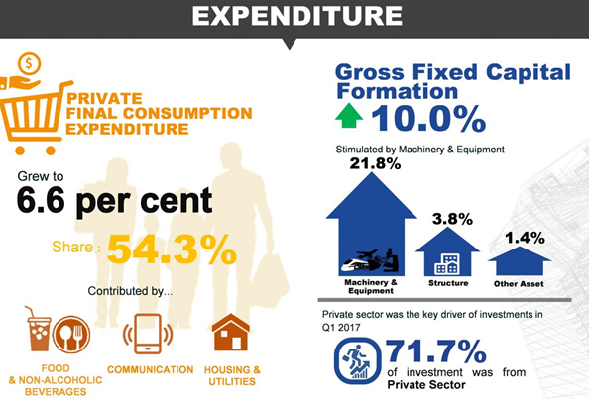
GDP BASED ON THE EXPENDITURE
2016 Q2
2017 Q1

Slide 7
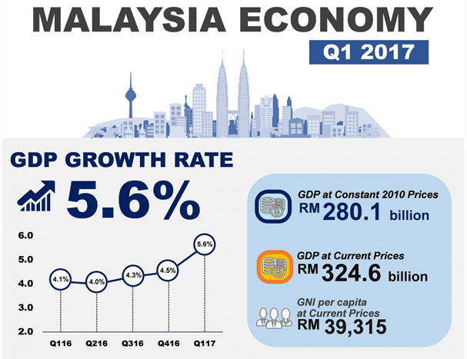
CONCLUSION

Slide 8
THE END

